Slide 1
An Empirical Analysis of UI-based Flaky Tests
Alan Romano
University at Buffalo, SUNY
Zihe Song
University of Texas at Dallas
Sampath Grandhi
University of Texas at Dallas
Wei Yang
University of Texas at Dallas
Weihang Wang
University at Buffalo, SUNY

Slide 2
Outline
Background
Study Details
Root Cause Categories
Manifestation Strategies
Fixing Strategies
Implications
Conclusion

Slide 3

Background
Photo by Olia Gozha on Unsplash

Slide 4
What are Flaky Tests?
Tests whose outcomes are non-deterministic
Same test and same code produce different results on different runs
Unreliable
Unsure which outcome is true
Observed in up to 45% of tests in studies [1,3], 16% in production [4]
Lead to wasted development time and resources

Slide 5
Flaky UI Tests
UI tests that intermittently produce different visual results in addition to traditional testing results
UI testing is significantly different from traditional unit testing
Events are highly asynchronous,
e.g. user input, API calls, rendering resources
Layer of complexity in use case scenarios introduced through:
Interaction between user and UI
Interaction between UI and test/application code

Slide 6

Study Details
Photo by Jay Ang on Unsplash

Slide 7
An Empirical Analysis on UI-Based Flaky Tests
Investigate 235 real-world flaky UI tests from web and Android projects
Study along 3 directions
Identify underlying root causes of flaky UI tests
Identify conditions that flaky UI tests manifest under and how they are reproduced
Identify typical fixing strategies for flaky UI tests

Slide 8
Methodology
Web Sample Collection
Inspect GitHub commits
Identify repositories using popular web UI framework keywords: react, angular, vue, emberjs, d3, svg, web, and bootstrap
Download all commits from repositories
Search commit messages for flak* and intermit*
Manually inspect to verify commit contains flaky test
Android Sample Collection
Inspect GitHub issues
Search through all GitHub issues through Github Archive
Search for flak* and intermit*
Search for keywords: android, ui, espresso, screen, ...

Slide 9
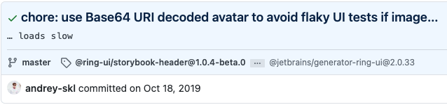
Example: JetBrains/ring-ui Commit
Root Cause: Image loading slow during test
Manifestation Strategy: Unspecified

Slide 10
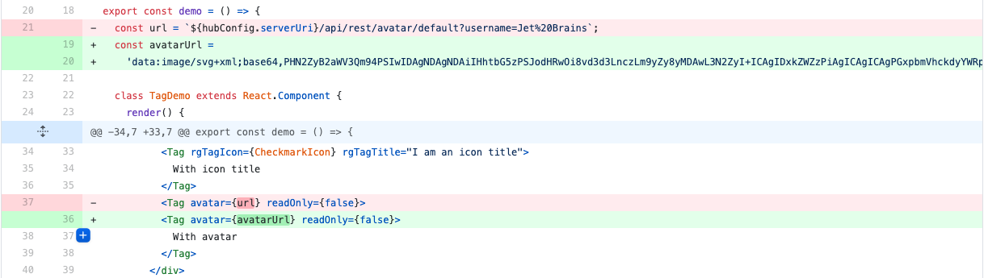
Example: JetBrains/ring-ui Commit (cont.)
Fixing Strategy: Work around network load through encoded base64 image

Slide 11
Flaky UI Test Dataset
Total: 235 Flaky UI Test Samples
Number of Web Samples: 152
Number of Projects: 25
Top 5 Projects:
Waterfox
Qutebrowser
Influxdb
Angular
plotly.js
Number of Mobile Samples: 83
Number of Projects: 37
Top 5 Projects:
Material-components-android
Focus-android
RxBinding
Xamarin.Forms
FirebaseUI-Android

Slide 12

Root Cause Categories
Photo by Markus Spiske on Unsplash

Slide 13
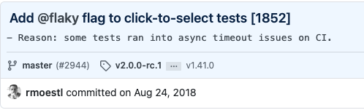
Async Wait
Network Resource Loading
Manipulate data or resources before fully loading
Resource Rendering
Perform UI action before component is fully rendered
Animation Timing Issue
Sensitive to timing differences in animation scheduling

Slide 14
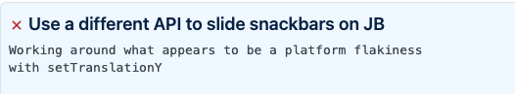
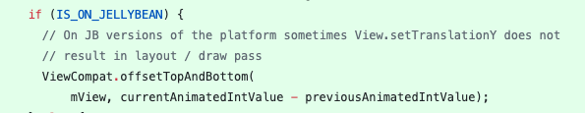
Environment
Platform Issue
Underlying issue or behavior in one particular platform affects UI test results
Layout Difference
Default layout rendering in different browsers cause UI results to differ

Slide 15
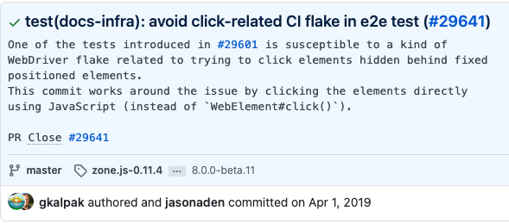
Test Runner API Issue
Incorrect Test Runner Interaction
APIs provided by testing tools contain an issue that leads to unexpected behavior
DOM Selector Issue
Differences in browsers implementation or stale elements can prevent selecting the correct DOM element in web applications

Slide 16
Test Script Logic Issue
Incorrect Resource Load Order
Code that loads UI resource and act on UI resource are in the incorrect order
E.g. call to act on resource is made after call to load resource
Time
Comparisons on time can be affected by speed of execution environment
Test Order Dependency
Tests depend on other tests in the test suite being run first
Randomness
Random data generation can create values that fall outside acceptable input space

Slide 17

Manifestation Strategies
Photo by Matt Seymour on Unsplash

Slide 18
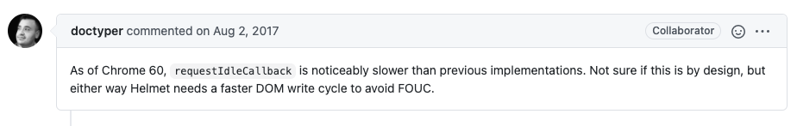
Specify Problematic Platform
For issues manifesting on a specific platforms, reporters can specify the problematic platform version to reproduce the flaky behavior

Slide 19
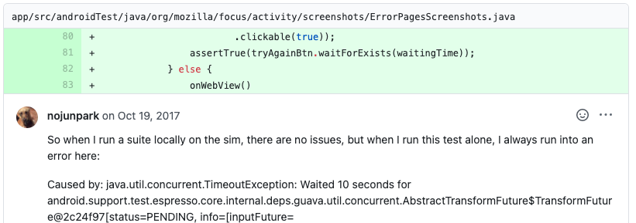
Reorder/Prune Test Suite
Rearranging test running order or running them alone can manifest order-dependent tests

Slide 20
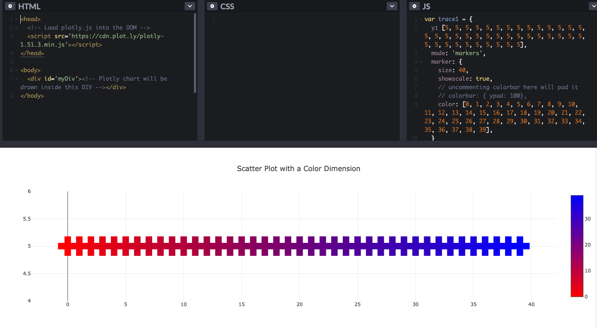
Provide Code Snippet
Reporters can include code snippets that reproduce flaky behavior outside of testing context

Slide 21
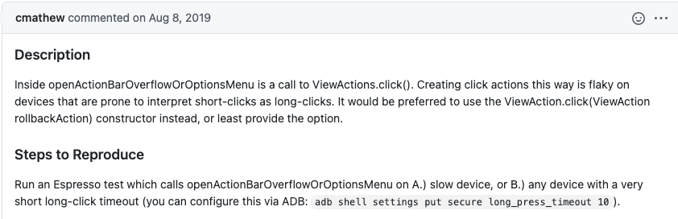
Force Environment Conditions
Flakiness that only appears on specific platforms or under certain configuration settings can manifest if those conditions are forcibly set

Slide 22

Fixing Strategies
Photo by Mink Mingle on Unsplash

Slide 23
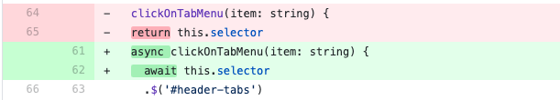
Delay
Add/Increase Delay
Increase the specified time to wait between actions to give more time to load
Fix Waiting Mechanism
Fix incorrect usage of a waiting mechanism that prevented the execution from pausing

Slide 24
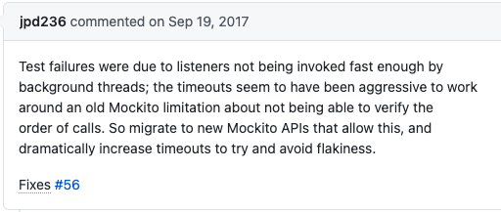
External Dependency
Fix Incorrect API Access
For tests that use incorrect APIs or misuse correct APIs, switching function used can fix flakiness
Change Library Versions
Projects can revert the version of the library containing the incorrect API to a working version

Slide 25
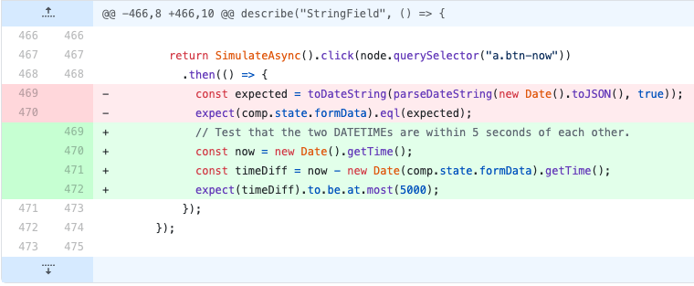
Refactor Test Checks
Refactor Logic Implementations
Change logic of checks performed while testing to remove flakiness

Slide 26
Disable Feature During Testing
Disable Animations
Completely disabled animation testing

Slide 27

Discussion
Photo by Syed F Hashemi on Unsplash

Slide 28
Implications
Async Wait issues being more prevalent in web projects than Android projects suggests more care must be taken when relying on network or resources loads within UI tests
Platform Issues affecting Android projects more than web projects suggest the fragmentation problem must be considered when choosing the test model
Preliminary design ideas for automated fixing strategies
Add/Increase Delay can be automated by automatically identifying delaying statements in tests and changing time
Fix Await Mechanism could be repaired by identifying incorrect asynchronous waiting statements

Slide 29
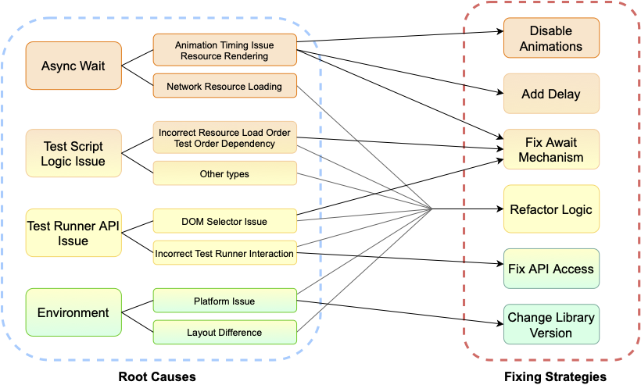
Root Causes and Fixing Strategies

Slide 30
Related Work
Empirical Studies on Software Defects
Chou et al. (2001) [5]
Lu et al. (2008) [6]
Sahoo et al. (2010) [7]
Studying Flaky Tests
Luo et al. (2014) [1]
Zhang et al.(2014) [8]
Goa et al. (2015) [9]
Thorve et al. (2018) [10]
Lam et al. (2019) [11]
Moran et al. (2019) [12]
Eck et al. (2019) [13]
Dong et al. (2020) [14]
Lam et al. (2020) [15]
Detecting and Fixing Flaky Tests
Bell et al. (2018) [16]
Lam et al. (2019) [17]
Shi et al. (2019)
Terragni et al. (2020)

Slide 31
References
Q. Luo, F. Hariri, L. Eloussi, and D. Marinov. An empirical analysis of flaky tests. In 22nd International Symposium on Foundations of Software Engineering (FSE 2014).
S. Zhang, D. Jalali, J. Wuttke, K. Muslu, W. Lam, M. D. Ernst, and D. Notkin. Empirically revisiting the test independence assumption. In 23rd International Symposium on Software Testing and Analysis (ISSTA 2014).
F. Palomba, and A. Zaidman. Does refactoring of test smells induce fixing flakey tests? In International conference on software maintenance and evolution (ICSME 2017).
Flaky Tests at Google and How We Mitigate Them. https://testing.googleblog.com/2016/05/flaky-tests-at-google-and-how-we.html. 2016.
Andy Chou, Junfeng Yang, Benjamin Chelf, Seth Hallem, and Dawson Engler. 2001. An empirical study of operating systems errors. SIGOPS Oper. Syst. Rev. 35, 5 (Dec. 2001), 73–88.
Shan Lu, Soyeon Park, Eunsoo Seo, and Yuanyuan Zhou. 2008. Learning from mistakes: a comprehensive study on real world concurrency bug characteristics. SIGPLAN Not. 43, 3 (March 2008), 329–339.
Swarup Kumar Sahoo, John Criswell, and Vikram Adve. 2010. An empirical study of reported bugs in server software with implications for automated bug diagnosis. In Proceedings of the 32nd ACM/IEEE International Conference on Software Engineering - Volume 1 (ICSE '10). Association for Computing Machinery, New York, NY, USA, 485–494.
Sai Zhang, Darioush Jalali, Jochen Wuttke, Kıvanç Muşlu, Wing Lam, Michael D. Ernst, and David Notkin. 2014. Empirically revisiting the test independence assumption. In Proceedings of the 2014 International Symposium on Software Testing and Analysis (ISSTA 2014). Association for Computing Machinery, New York, NY, USA, 385–396.
Z. Gao, Y. Liang, M. B. Cohen, A. M. Memon and Z. Wang, "Making System User Interactive Tests Repeatable: When and What Should We Control?," 2015 IEEE/ACM 37th IEEE International Conference on Software Engineering, 2015, pp. 55-65, doi: 10.1109/ICSE.2015.28.
Thorve, Swapna & Sreshtha, Chandani & Meng, Na. (2018). An Empirical Study of Flaky Tests in Android Apps. 534-538. 10.1109/ICSME.2018.00062.

Slide 32
References (cont.)
Thorve, Swapna & Sreshtha, Chandani & Meng, Na. (2018). An Empirical Study of Flaky Tests in Android Apps. 534-538. 10.1109/ICSME.2018.00062.
Moran, Jesus & Augusto Alonso, Cristian & Bertolino, Antonia & de la Riva, Claudio & Tuya, Javier. (2019). Debugging Flaky Tests on Web Applications. 454-461. 10.5220/0008559004540461.
Eck, Moritz & Palomba, Fabio & Castelluccio, Marco & Bacchelli, Alberto. (2019). Understanding flaky tests: the developer’s perspective. 830-840. 10.1145/3338906.3338945.
Dong, Zhen & Tiwari, Abhishek & Yu, Xiao & Roychoudhury, Abhik. (2020). Concurrency-related Flaky Test Detection in Android apps.
Wing Lam, Kıvanç Muşlu, Hitesh Sajnani, and Suresh Thummalapenta. 2020. A study on the lifecycle of flaky tests. In Proceedings of the ACM/IEEE 42nd International Conference on Software Engineering (ICSE '20). Association for Computing Machinery, New York, NY, USA, 1471–1482.
J. Bell, O. Legunsen, M. Hilton, L. Eloussi, T. Yung and D. Marinov, "DeFlaker: Automatically Detecting Flaky Tests," 2018 IEEE/ACM 40th International Conference on Software Engineering (ICSE), 2018, pp. 433-444
August Shi, Wing Lam, Reed Oei, Tao Xie, and Darko Marinov. 2019. IFixFlakies: a framework for automatically fixing order-dependent flaky tests. In Proceedings of the 2019 27th ACM Joint Meeting on European Software Engineering Conference and Symposium on the Foundations of Software Engineering(ESEC/FSE 2019). Association for Computing Machinery, New York, NY, USA, 545–555.
Valerio Terragni, Pasquale Salza, and Filomena Ferrucci. 2020. A container-based infrastructure for fuzzy-driven root causing of flaky tests. In Proceedings of the ACM/IEEE 42nd International Conference on Software Engineering: New Ideas and Emerging Results (ICSE-NIER '20). Association for Computing Machinery, New York, NY, USA, 69–72.

Slide 33
Conclusion
Perform an empirical study on UI tests containing flaky behavior
Investigate 235 flaky UI test samples from web and Android projects
Identify root causes of flaky UI tests and identify new categories specific to UI tests
Identify manifestation strategies used to reliably reproduce flaky behavior
Identify fixing strategies applied on samples

Slide 34
Thank You For Watching!
Alan Romano
University at Buffalo, SUNY
Zihe Song
University of Texas at Dallas
Sampath Grandhi
University of Texas at Dallas
Wei Yang
University of Texas at Dallas
Weihang Wang
University at Buffalo, SUNY

